Slide 1

Unveiling CPU Microarchitecture: A Visual Journey
Welcome to an interactive exploration of CPU architecture, designed to demystify complex concepts for students and programmers alike. Through visual simulations, we'll dive deep into the fascinating world of parallel computing and processor-level mechanics.

Slide 2

The Challenge: Understanding Parallelism
Parallel computing offers immense potential for performance gains, but truly grasping its nuances can be challenging. Our project aims to bridge this gap, providing clear, visual explanations for abstract principles.
Simplifying complex concepts
Bridging theory and practical application
Visualizing performance bottlenecks

Slide 3

Experiential Learning Through Visual Simulations
Web-Based Interface
Interactive Controls
Concept Clarity
Accessible anytime, anywhere, fostering flexible learning environments.
Adjust parameters and observe real-time changes in system behavior.
Transforming abstract ideas into tangible, visual experiences.

Slide 4
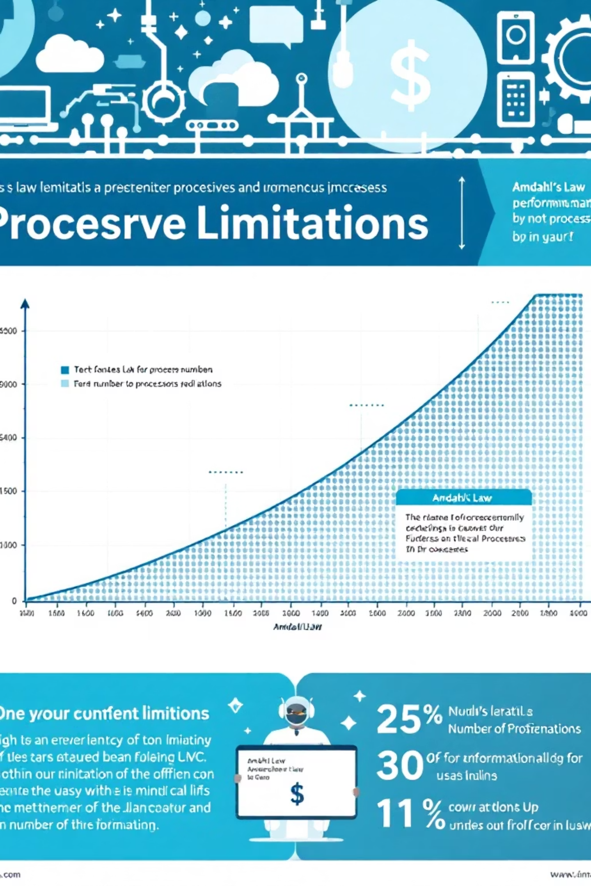

Understanding Amdahl's Law: The Sequential Bottleneck
Amdahl's Law reveals a fundamental truth about parallelization: the sequential portion of any program inherently limits the maximum speedup achievable, regardless of how many processors are added.
This law highlights the critical importance of optimizing serial code sections for significant overall performance improvement.

Slide 5

Visualizing Amdahl's Law in Action
Interactive Simulation
Processor Scalability
Our tool allows you to manipulate the percentage of sequential code and observe its direct impact on potential speedup.
Watch as adding more processors yields diminishing returns when a program isn't fully parallelizable.
Optimizing Performance
Gain insights into where to focus optimization efforts to maximize parallel efficiency.

Slide 6
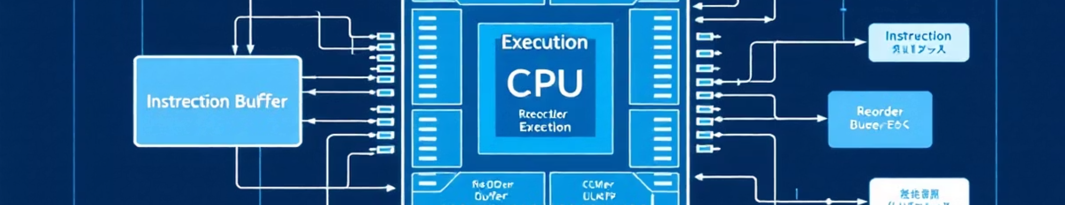
Unraveling the Tomasulo Algorithm
Modern CPUs are incredibly complex, employing sophisticated techniques to boost execution efficiency. The Tomasulo algorithm is a prime example, enabling dynamic instruction scheduling and out-of-order execution.
"Tomasulo's algorithm changed how processors handle instruction execution, marking a significant leap in microarchitecture design."

Slide 7
How Tomasulo Boosts Efficiency
01
02
Instruction Fetch & Issue
Out-of-Order Execution
Instructions are fetched and placed in reservation stations, waiting for operands.
Instructions execute as soon as their operands are ready, not strictly in program order, avoiding stalls.
03
04
Common Data Bus (CDB)
Commit to Registers
Results are broadcast on the CDB, allowing dependent instructions to proceed immediately.
Results are written to the architectural registers in program order, maintaining correctness.

Slide 8
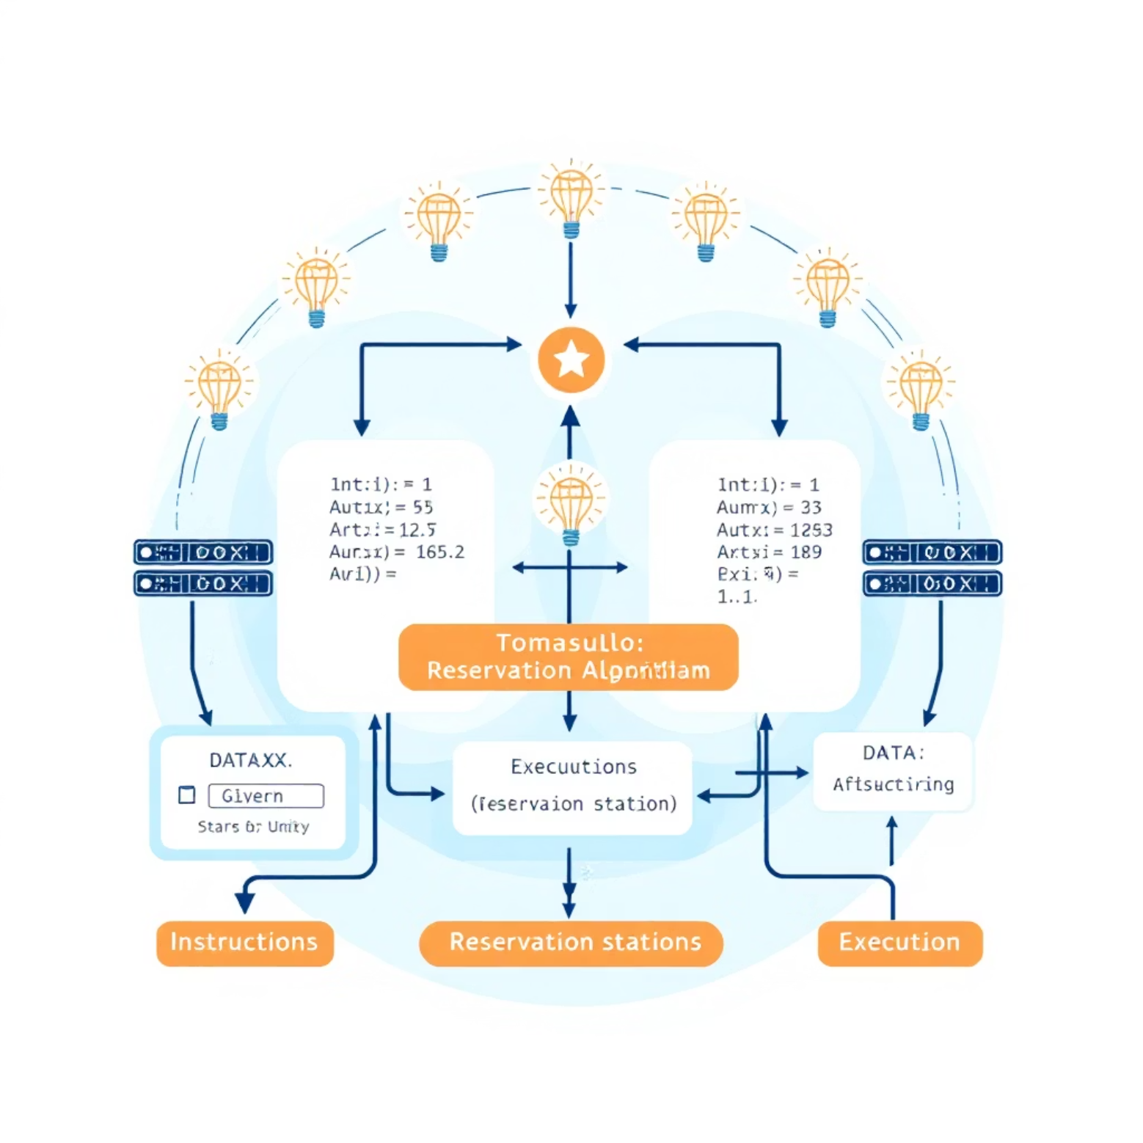
Visualizing Dynamic Scheduling
Our simulation brings the intricate dance of the Tomasulo algorithm to life. See reservation stations, functional units, and the reorder buffer actively manage instructions.
Track instruction movement
Observe data dependencies resolve
Understand out-of-order execution

Slide 9

The Power of Real-Time Interaction
Adjust Parameters
Instant Feedback
Deepen Understanding
Modify CPU pipeline stages, functional unit counts, and instruction types.
Observe immediate visual changes in execution patterns and performance metrics.
Move beyond theoretical knowledge to practical, intuitive comprehension.

Slide 10



Empowering the Next Generation of Programmers
This project serves as a vital tool for educators and self-taught programmers, making the once-daunting concepts of CPU microarchitecture accessible and engaging. Prepare to unlock a deeper understanding of how software truly interacts with hardware.

